Slide 1
E R Diagram

Slide 2
Entity-Relationship Model
used for conceptual data modeling
developed by Peter Chen in 1970s
made up of entities, relationships, and attributes

Slide 3
E-R Model
is a detailed, logical representation of the data of an organization (entities), relationships (or associations) among entities and attributes.
allows us to identify relationships between entities - at best it provides a broad overview of relationships

Slide 4
E-R Diagram
an entity relationship diagram is a graphical representation of an E-R model
  Components
    Entities
    Attributes (and identifiers)
    Relationships

Slide 5
Entities
What is an entity?
  person, place, object, event, or concept about which an organization (or users) want to maintain data about (or track)
Examples:
  Person: EMPLOYEE, STUDENT, PATIENT
  Place: STATE, REGION, COUNTRY
  Object: MACHINE, BUILDING, AUTOMOBILE
  Event: SALE, REGISTRATION, RENEWAL
  Concept: ACCOUNT, COURSE, WORK CENTER

Slide 6
Attributes
Properties of an entity are attributes.
Attributes tell the characteristics of that entity.
Every entity has at least one attribute
Example →
  Student entity has the rollno, name attributes.
  Customer entity has custid, qty, date_of_transaction attributes.

Slide 7
Relationships or Cardinality
are an association between instances of one or more entity types of interest to the organization
  One-to-one (1:1)
  One-to-many (1:M)
  Many-to-many (M:N)

Slide 8
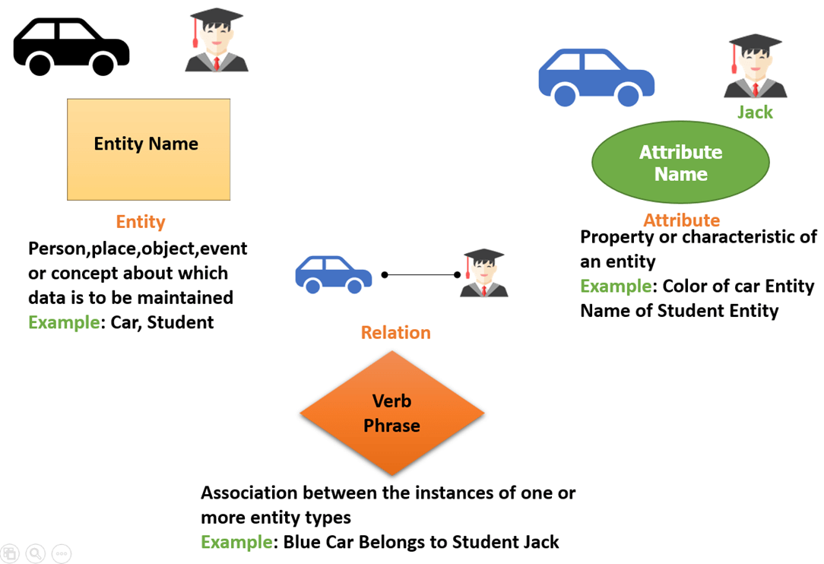
Conceptual Example of Entity, Attribute and Relationship

Slide 9
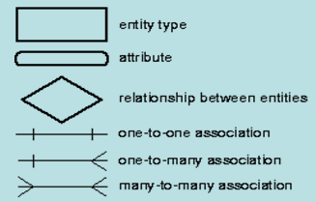
ER Notations

Slide 10
One-to-One relationship
described as 1:1
a single-entity instance of one entity type is related to a single entity instance of another type
primary key of one would be foreign key in the other

Slide 11
One-to-One Relationship
Employee
is assigned to
Office
Every employee is assigned to exactly one office and every office is assigned one employee. (i.e. In the office entity the same employees information will come only once).
That means, in one-to-one the Foreign Key will also have Unique Key and Not Null constraints applied on it.

Slide 12
One-to-Many relationship
described as 1:M
a single instance of one entity related to many instances of another entity
parent-child relationship
  parent is the one side (primary table)
  child is the many side (related table)
place key of parent table in child table

Slide 13
One to Many Relationship
One to many relationship has two types of Participation of the many side entity.
Total Participation
Partial Participation

Slide 14
One to Many Relationship
Total participation at both the ends.
E.g. One Faculty associated with many students
In Total Participation the Foreign Key will also have NOT NULL constraint applied on it.
One Faculty
Students
teaches

Slide 15
One to Many Relationship
Partial participation at the other end.
An System Analyst may be in charge of many projects (or may not be in charge of any) and every project has exactly one systems analyst in charge.
In Partial Participation the Foreign Key value can be null, which is the default behavior.
System Analyst
Projects
Is in charge of

Slide 16
Many-to-Many relationship
described as M:N
many instances of one entity relate to many instances of another entity
must be separated into additional 1:M relations

Slide 17
Many to Many Relationship
E.g.1
Salesperson
is assigned to call on
Customer
Every salesperson is assigned to call on one or more customers, and every customer has one or more salespersons assigned to call.

Slide 18
Many to Many Relationship
E.g.2
Users
Have
Permissions
An user will have one or multiple permissions.
At the same time a single permission can be given to multiple users!!

Slide 19
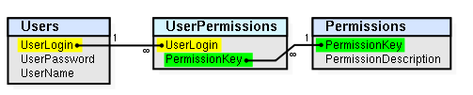
Link Table/ Junction Table / Bridge/ Associative Table
Junction/Link/Bridge/Associative table is employed when dealing with many-to-many relationships in a database.
Date_of_Permissiont
Assigned_Byt
Reason t

Slide 20
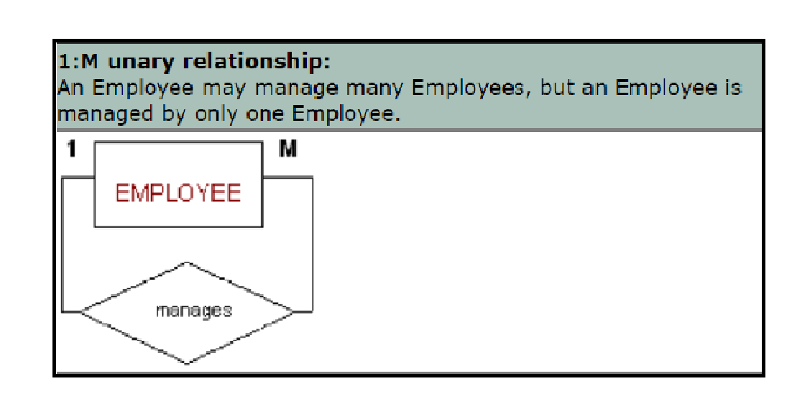
Representing the Recursive Relationship Or Unary Relationship in ERD

Slide 21
  Real Life Examples of ERD

Slide 22
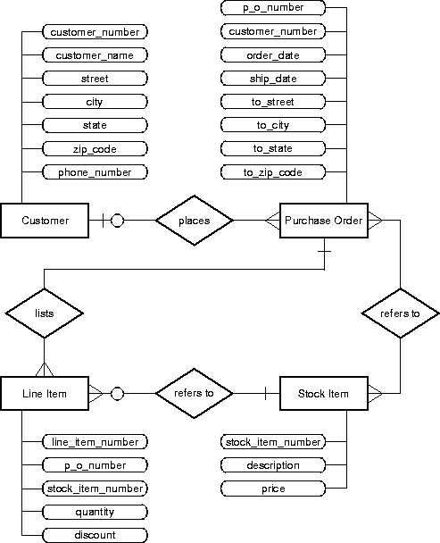

Slide 23
